Slide 1

Title: Profit and Loss
EQ – How can we express Profit & Loss as a %?

Slide 2
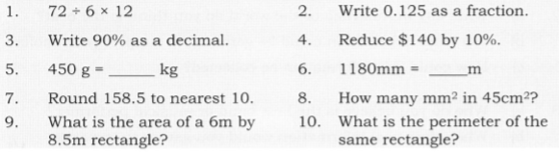
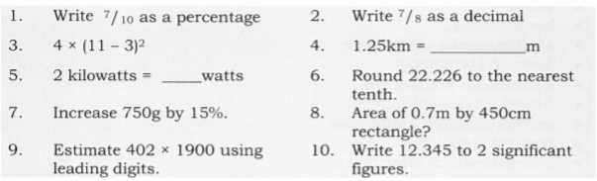
Warm ups

Slide 3
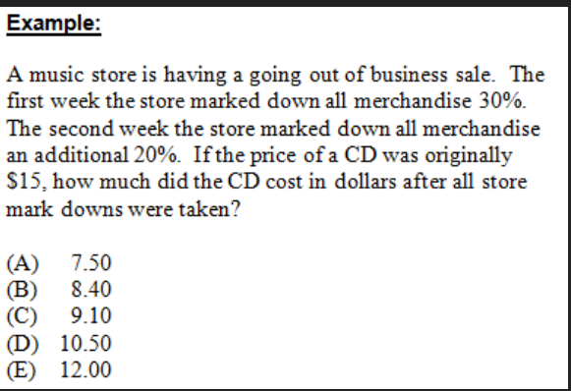
Review from last lesson
A furniture shop was having a 20% off sale on all chairs. Ms. Latham picked out a chair that was originally worth $40, how much did she pay for the chair?
Mr. Summers was visiting Canada and had dinner at a restaurant that cost him $30 and he needed to add an 18% tip, how much did he have to pay altogether?

Slide 4
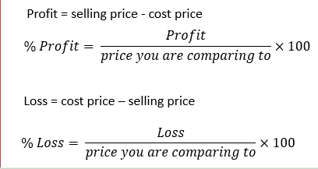
24
7
30
Date
Title: Profit and Loss
EQ – How can we express Profit & Loss as a %?
What is profit & loss?
if you make money by selling an item for more than you bought it for than you make a Profit, if you loose money by selling an item for less than you bought it for it is a Loss
You can express the Profit or Loss to the SP or the CP
Selling price – how much the item is sold for
Cost price – how much the item was originally bought for
What are we comparing to?
5

Slide 5
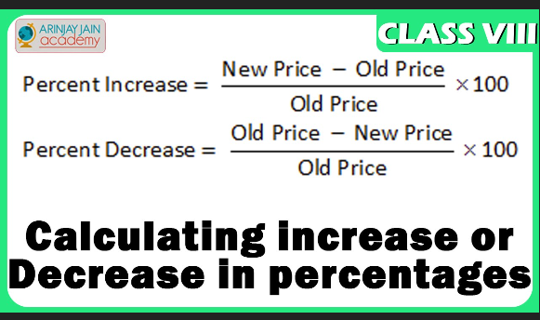
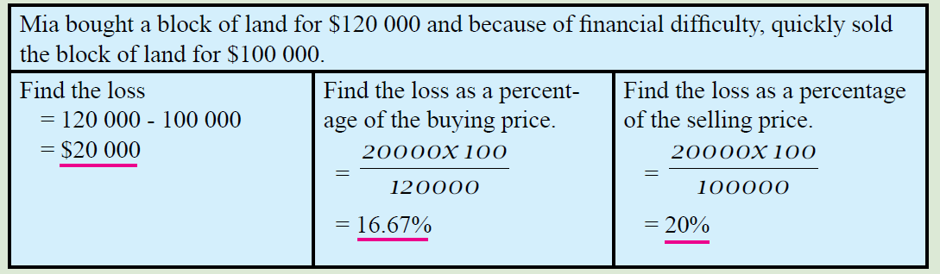
24
7
30
Date
Title: Profit and Loss
EQ – How can we express Profit & Loss as a %?
How to calculate the % Profit ?
How to calculate the % Loss?
5

Slide 6
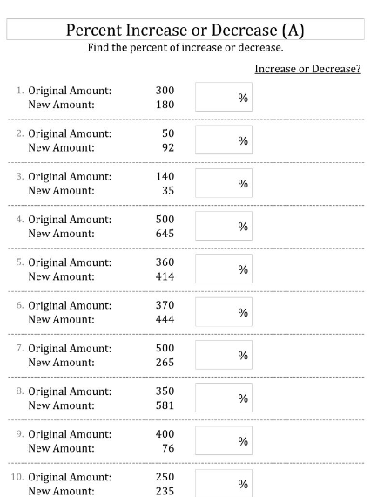

Slide 7

Complete the worksheet on finding percentage change

